Slide 1
Project Paraguay July 2015

Slide 2
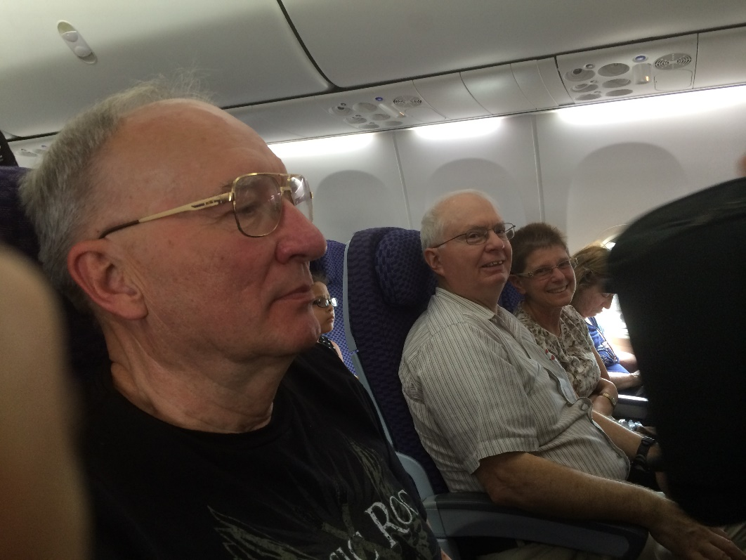
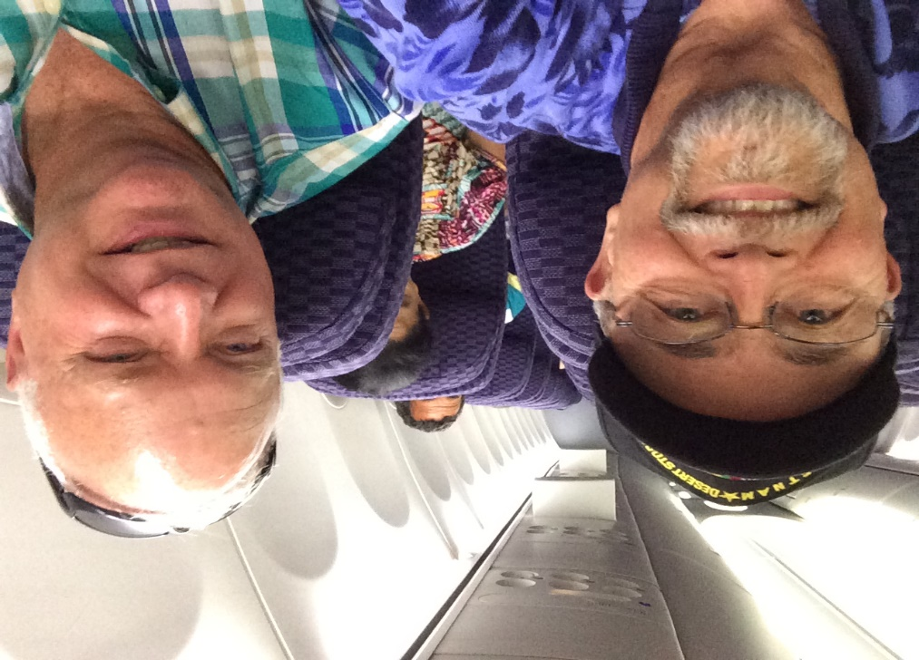
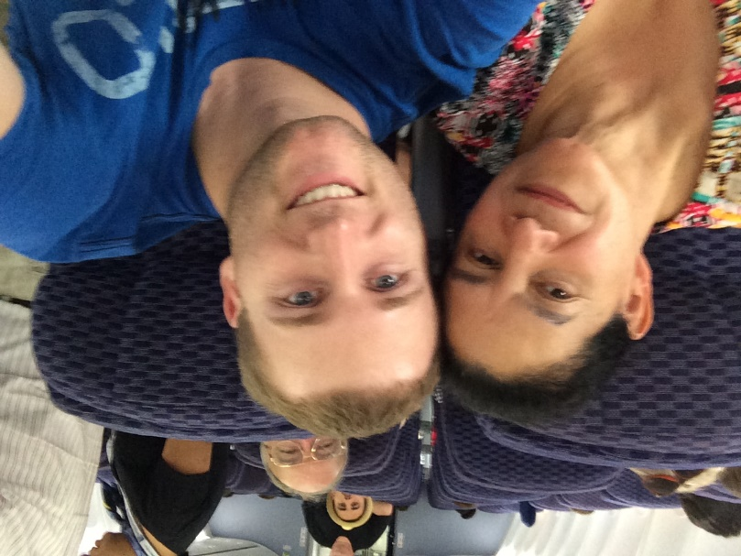
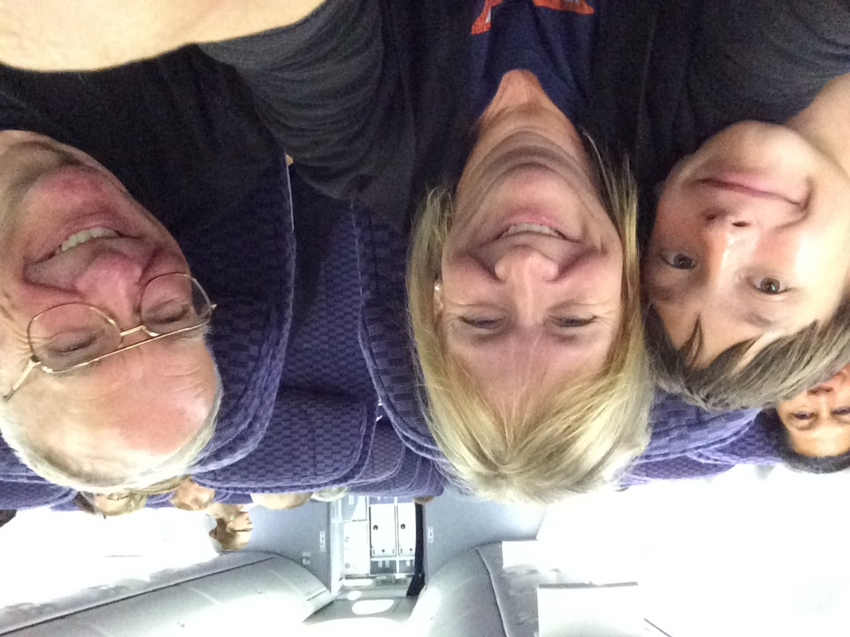
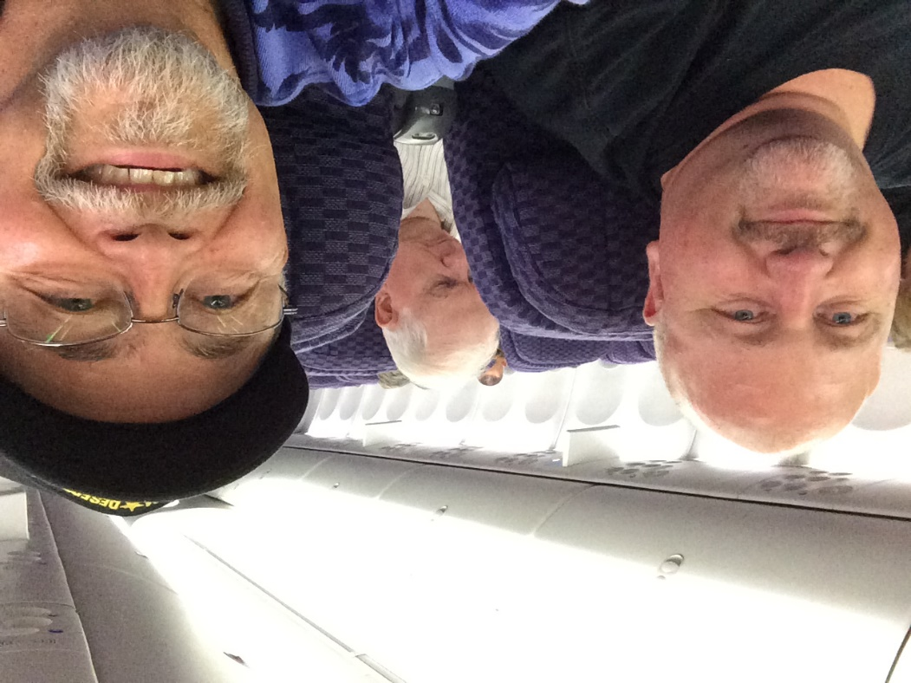
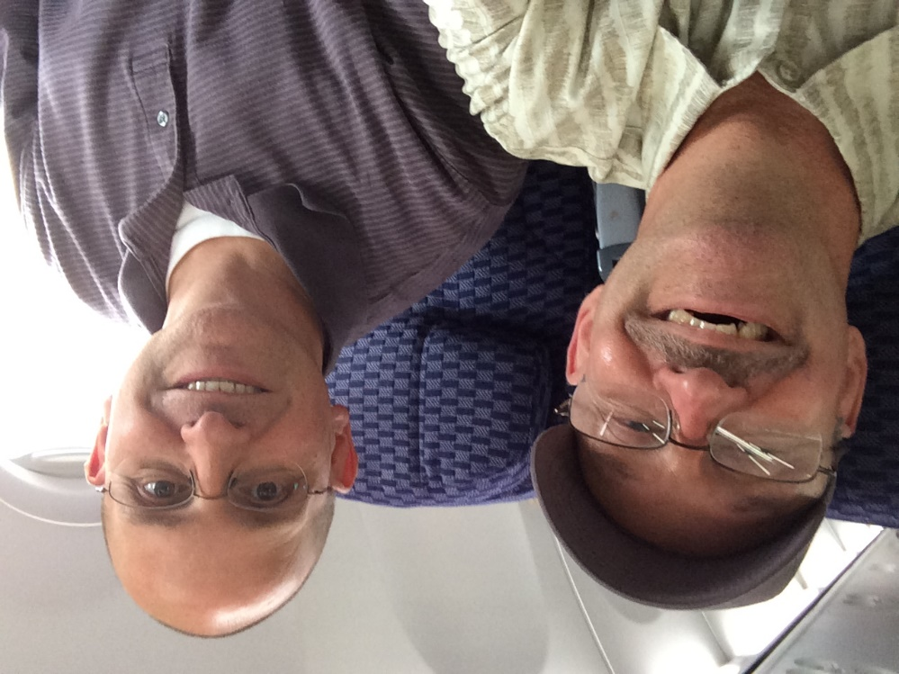
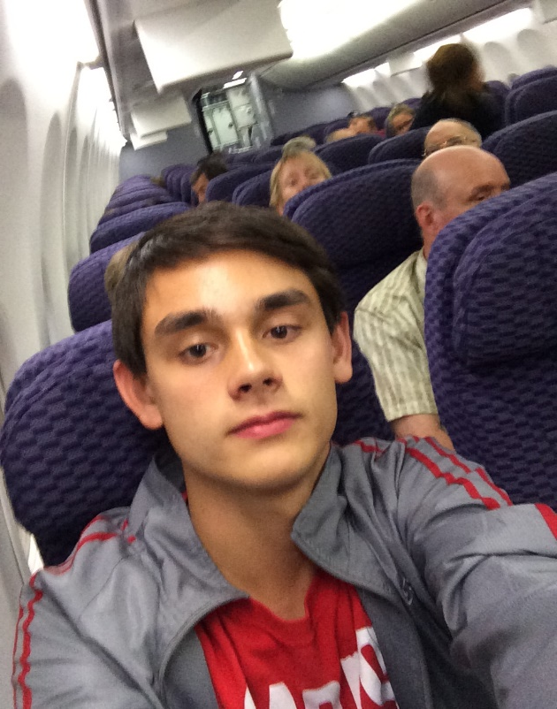
Our Team….
Gordon and Mike
Gpa Dave, Bob and Nancy
Tana and Micheal
Kean and Pastor Phil
Joseph, Annette
AG
……

Slide 3
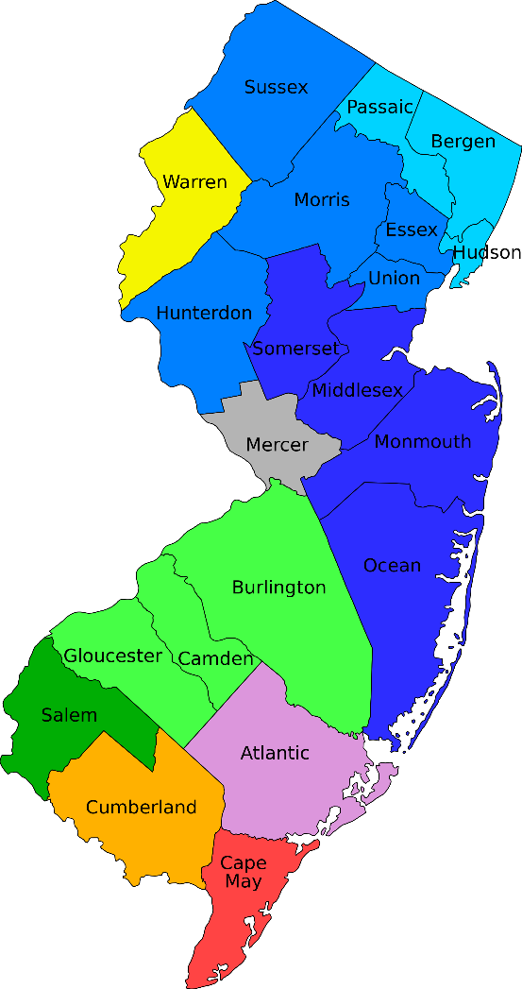
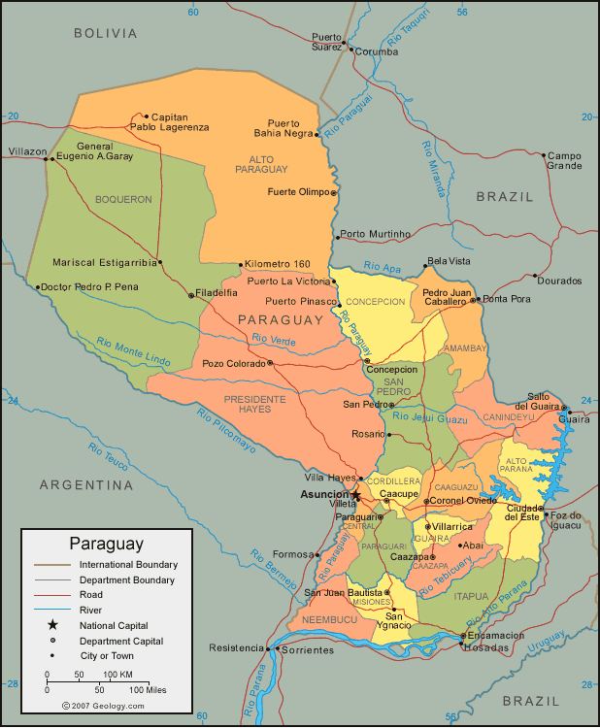
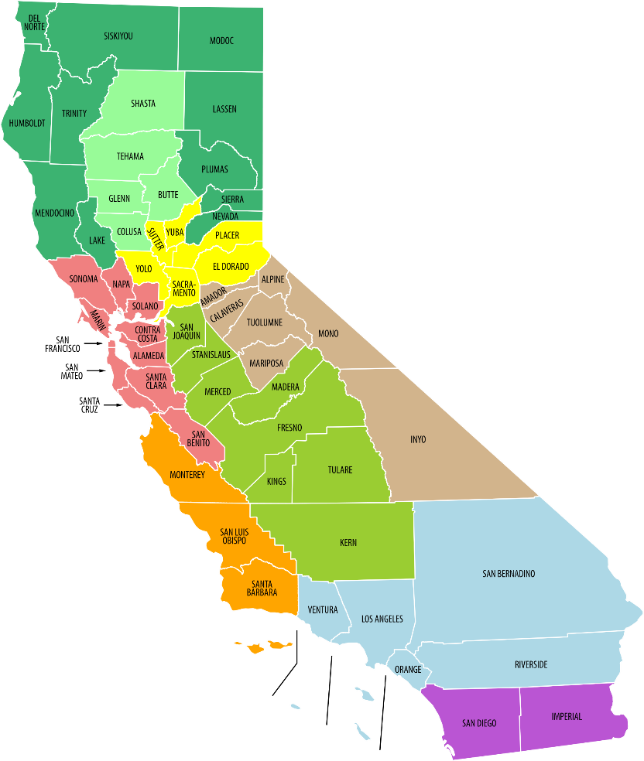
Paraguay: Shaped Like New Jersey but the Size of California
8,722.58 sq mi
157,048 sq mi
163,696 sq mi
163,696 sq mi

Slide 4
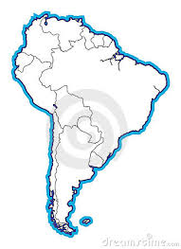
Where In the World is Paraguay?
Hint:
It’s in South America.
Paraguay is right here?

Slide 5
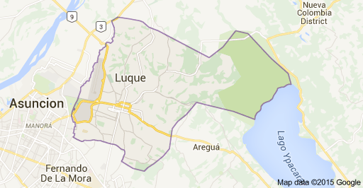
Luque A suburb of Asuncion
Barrio Parque
El Renuevo

Slide 6
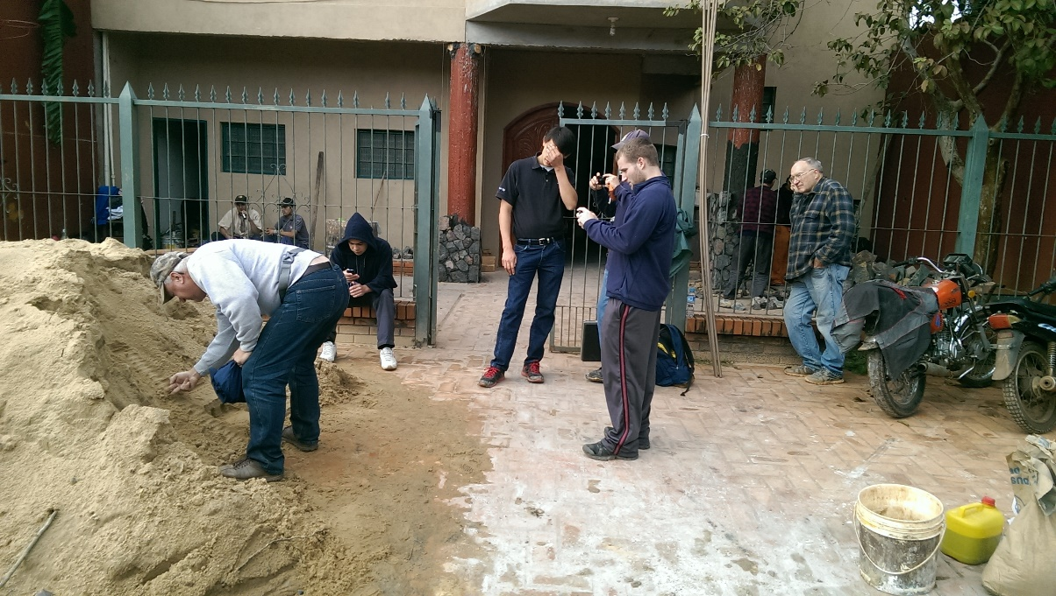
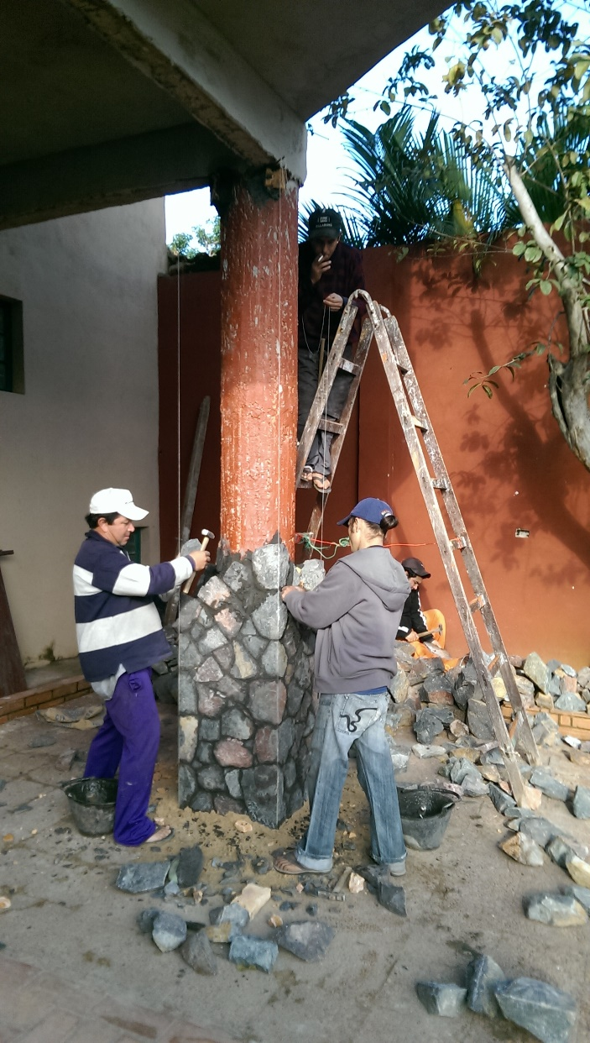
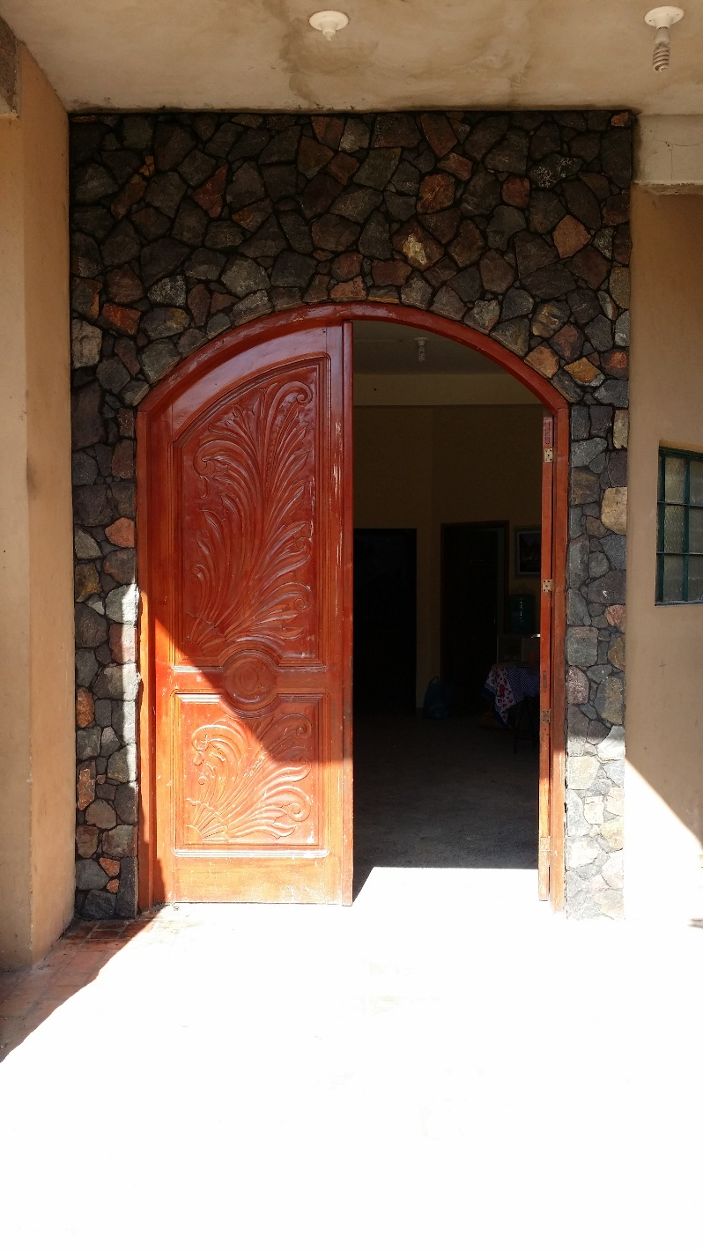
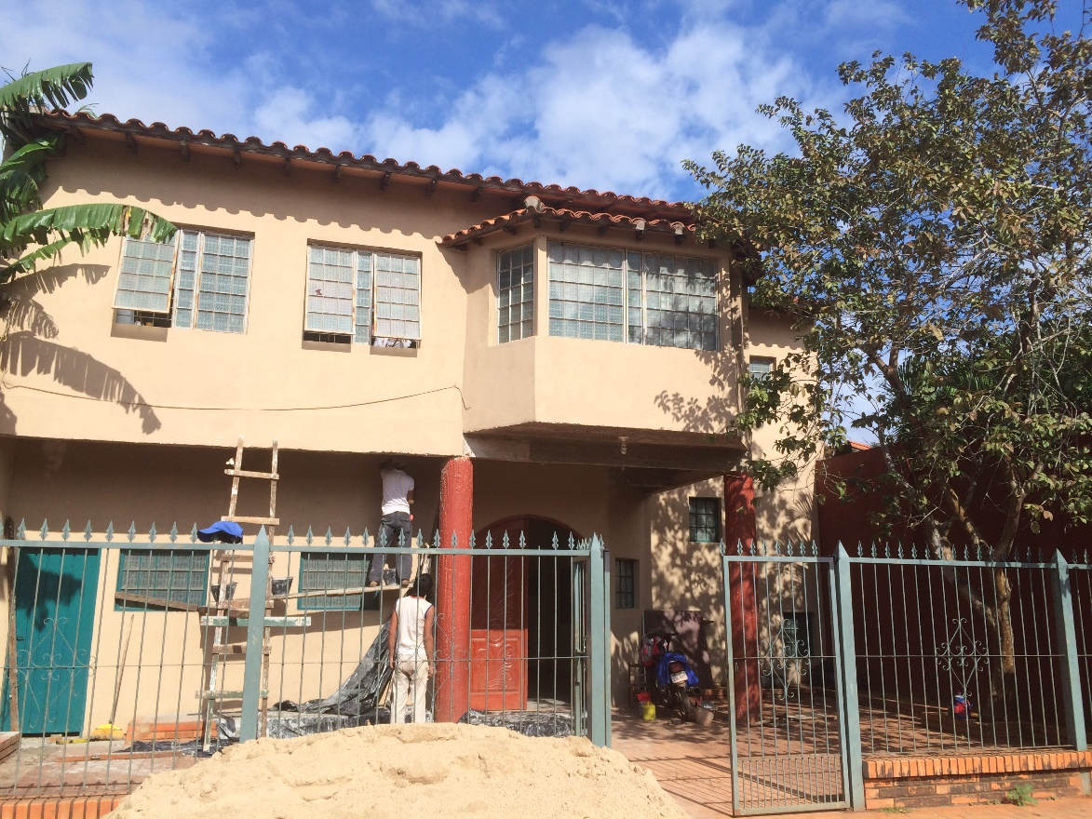
El Renuevo…

Slide 7
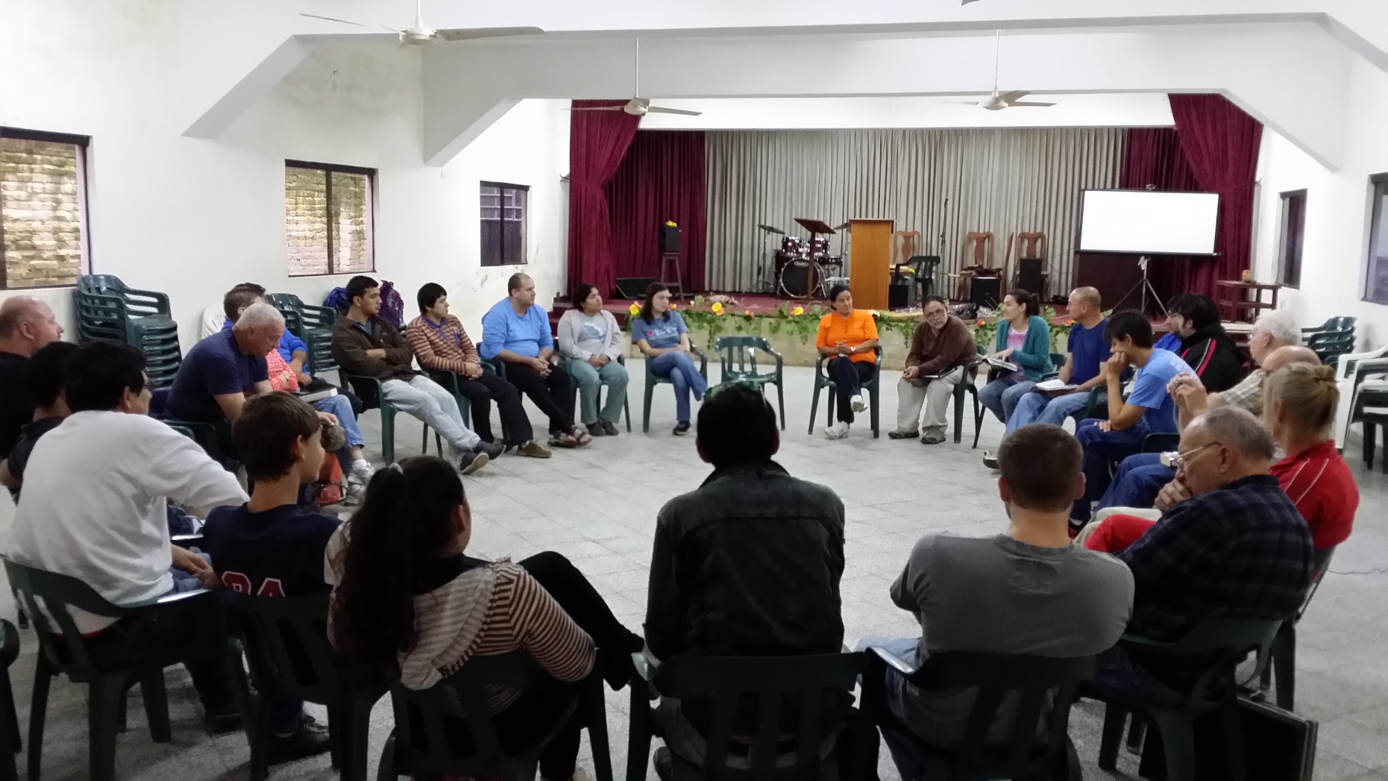
Our Official Reception At Renuevo
We landed at 4 AM and went to our host families.
We gathered at El Renuevo at 11 AM for our in-brief…
…the itinerary for the week
And……

Slide 8
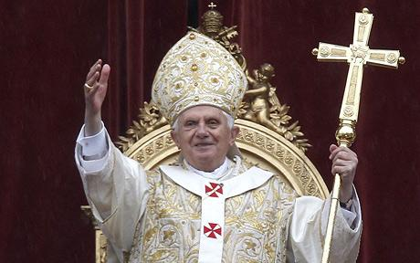
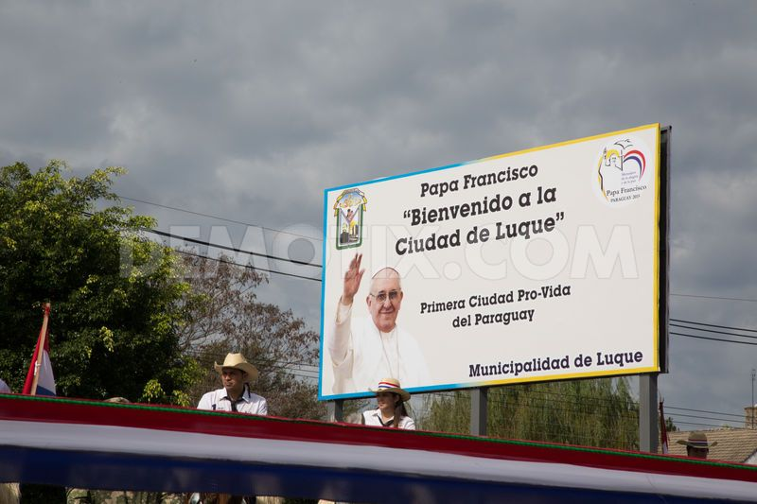
Our First Blessing!
The streets were barricaded and police were everywhere stopping vehicular traffic….but that WAS a blessing!
Bu God had all under control. We needed this time to plan and organize our work!

Slide 9
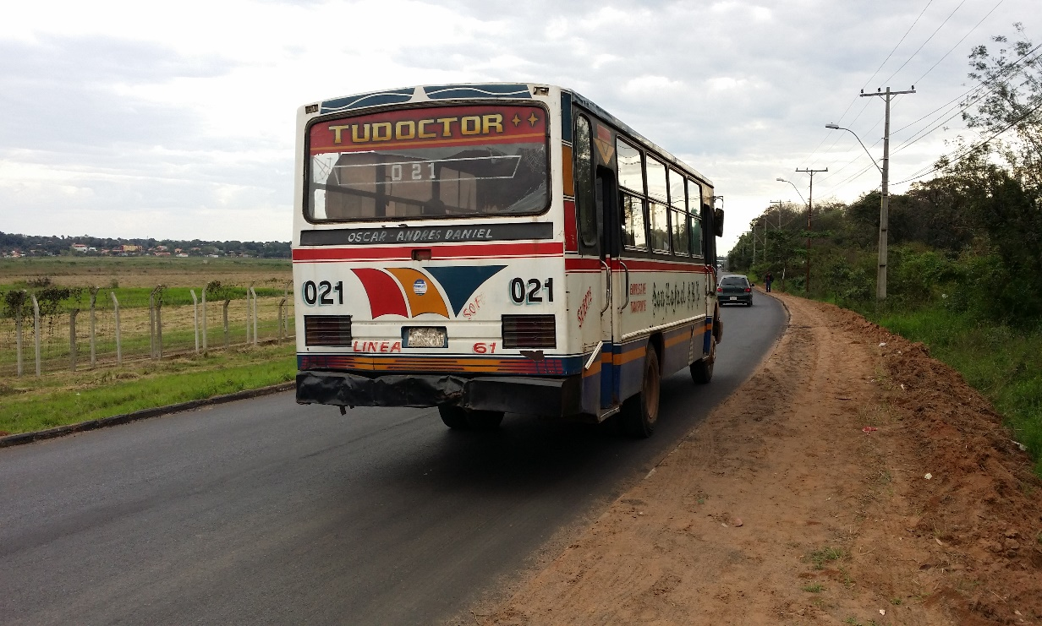
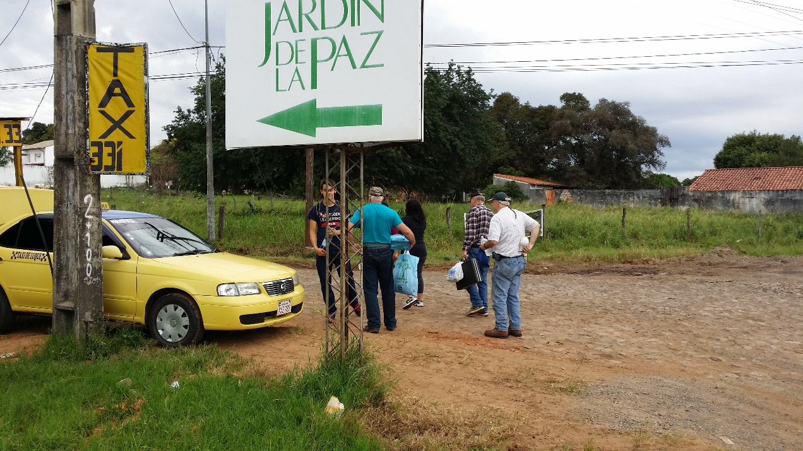
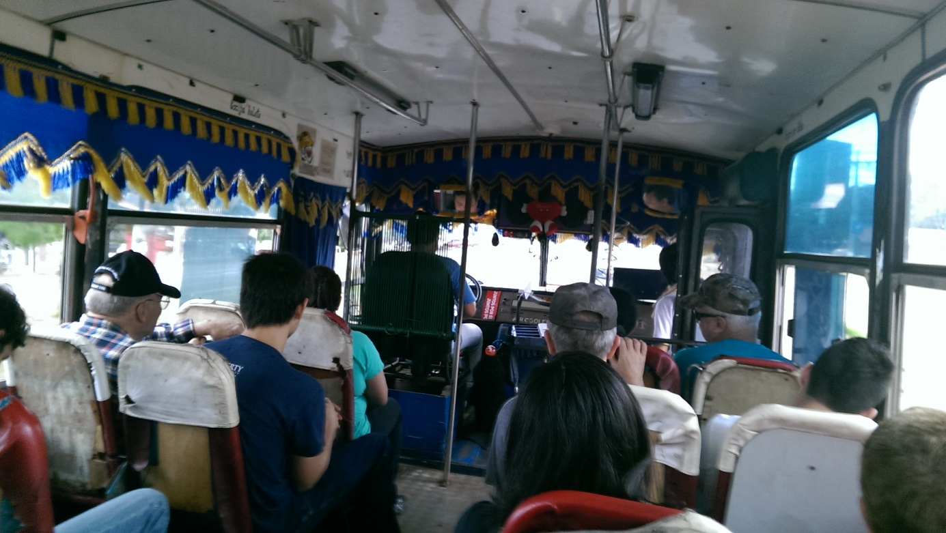
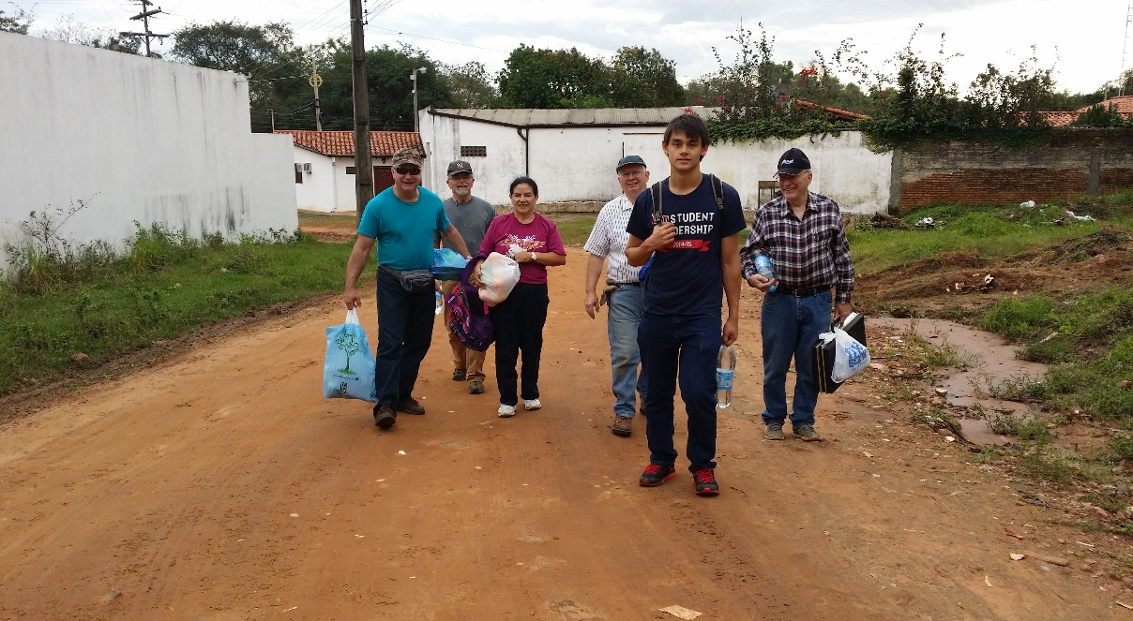
Getting to Barrio Parque
After the bus…….
El Collectivo
Waiting for…El Collectivo
On the way to Barrio Parque
The last mile…..

Slide 10
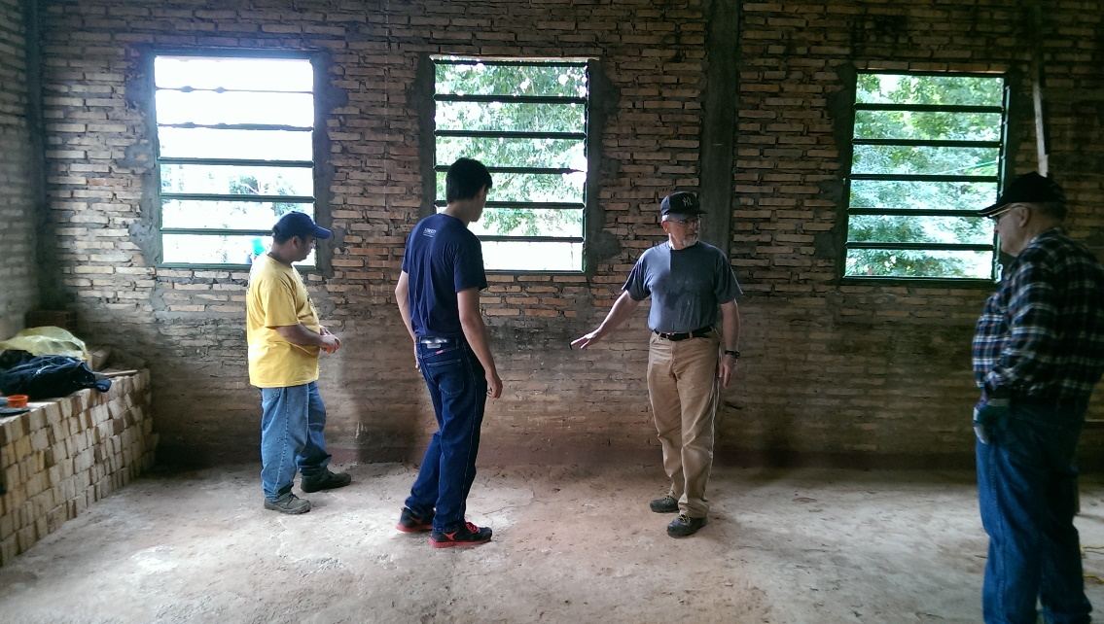
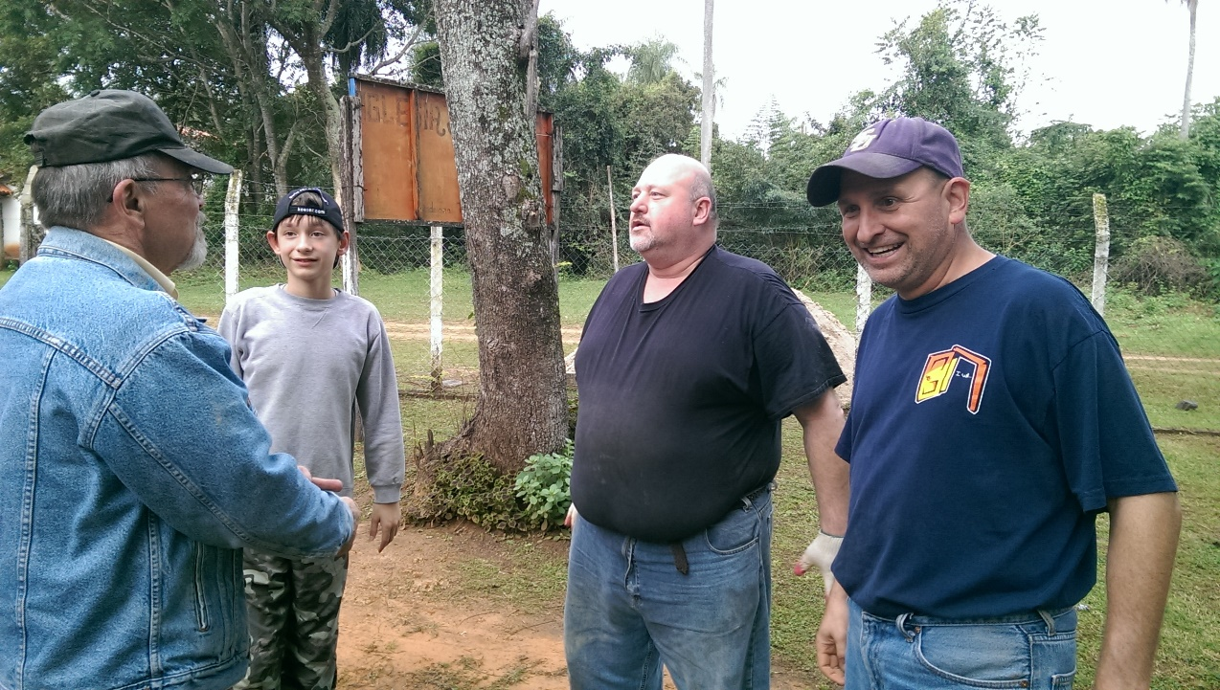
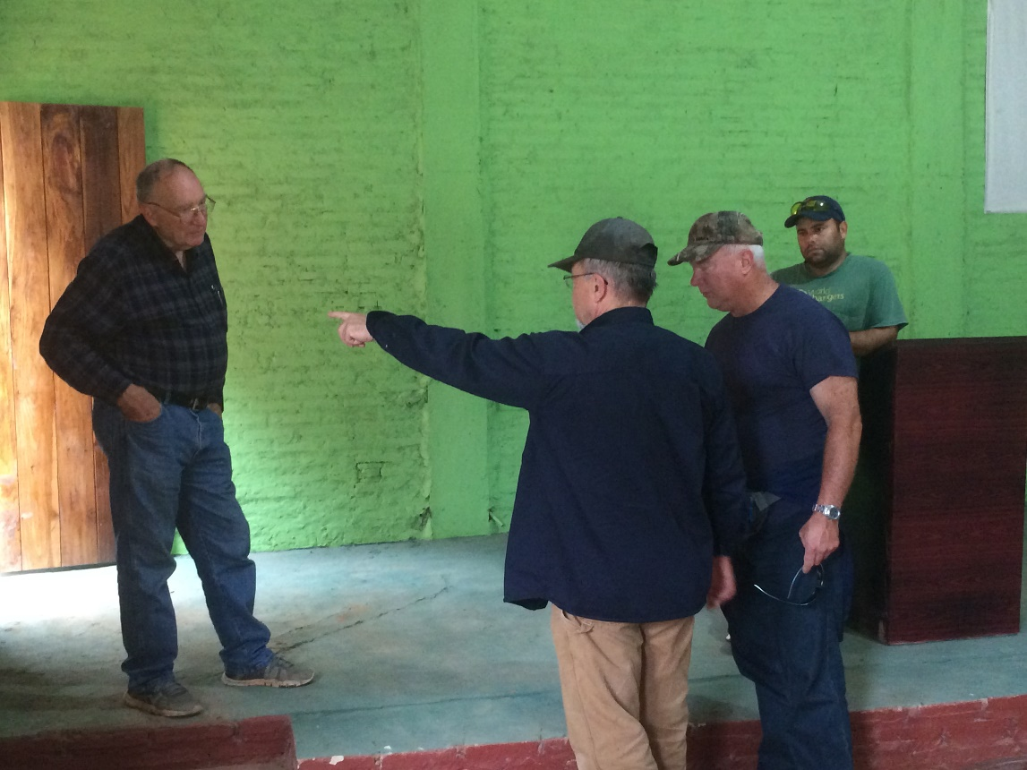
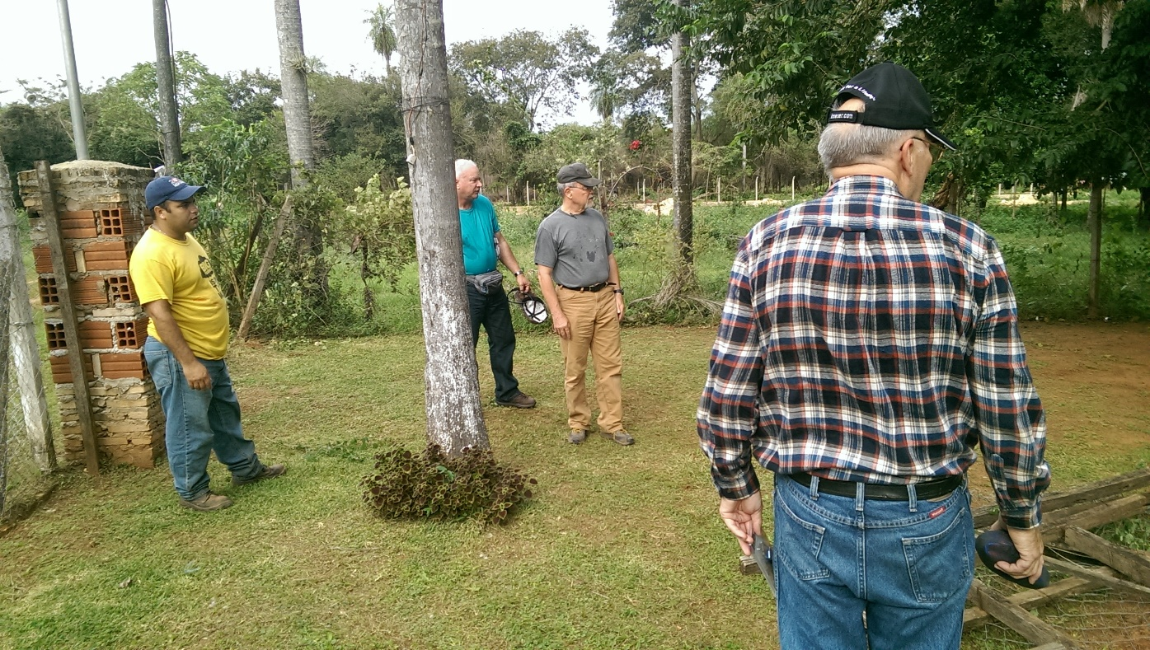
Making the Work Assignments
Everyone Works…
Laying out the inside….
Laying out the outside….

Slide 11
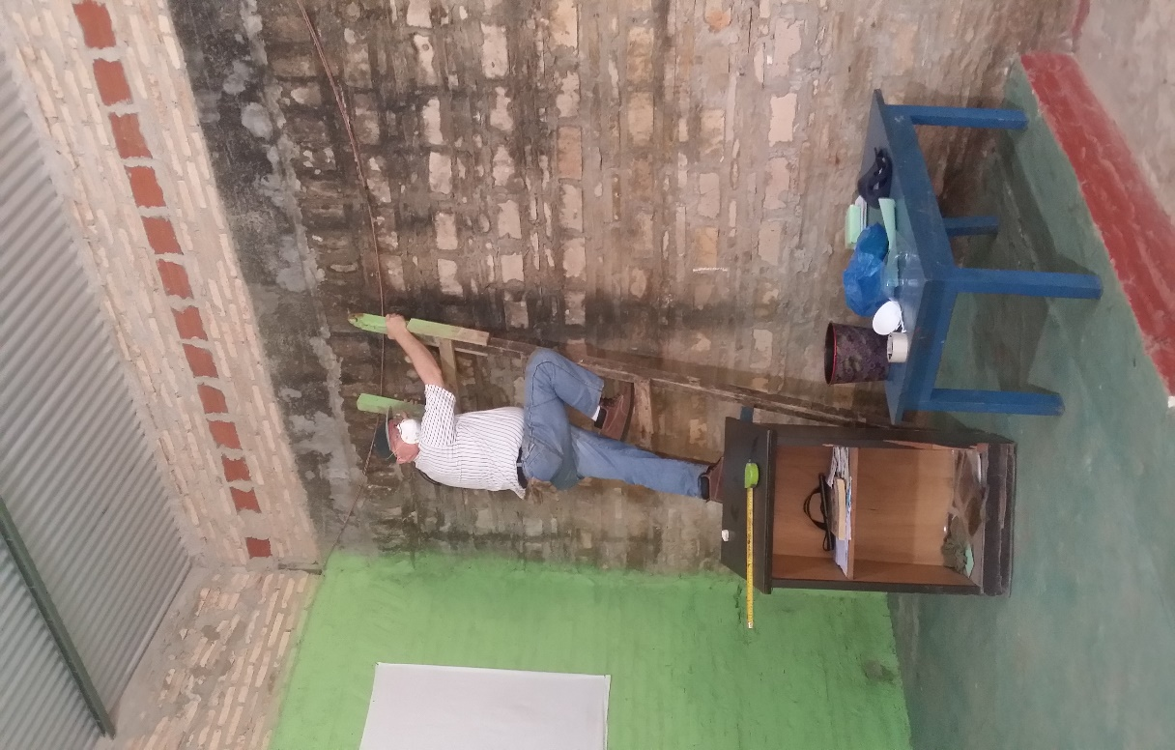
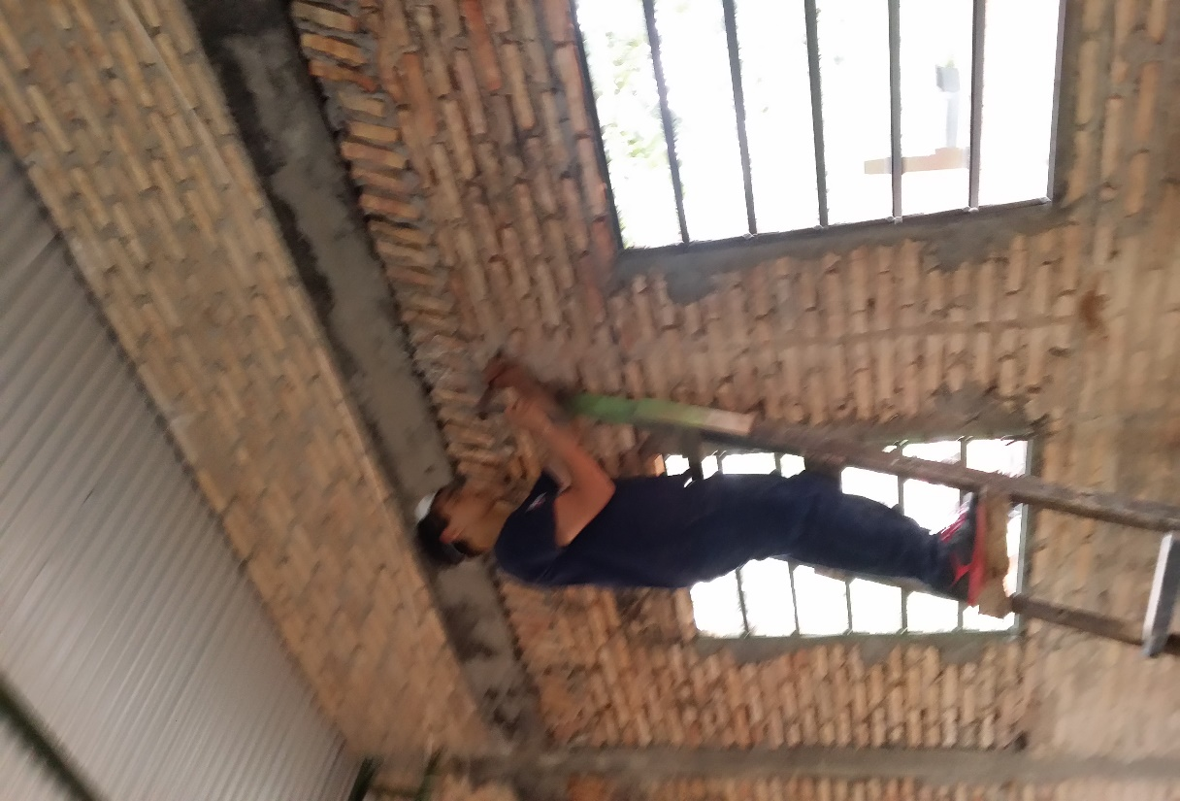
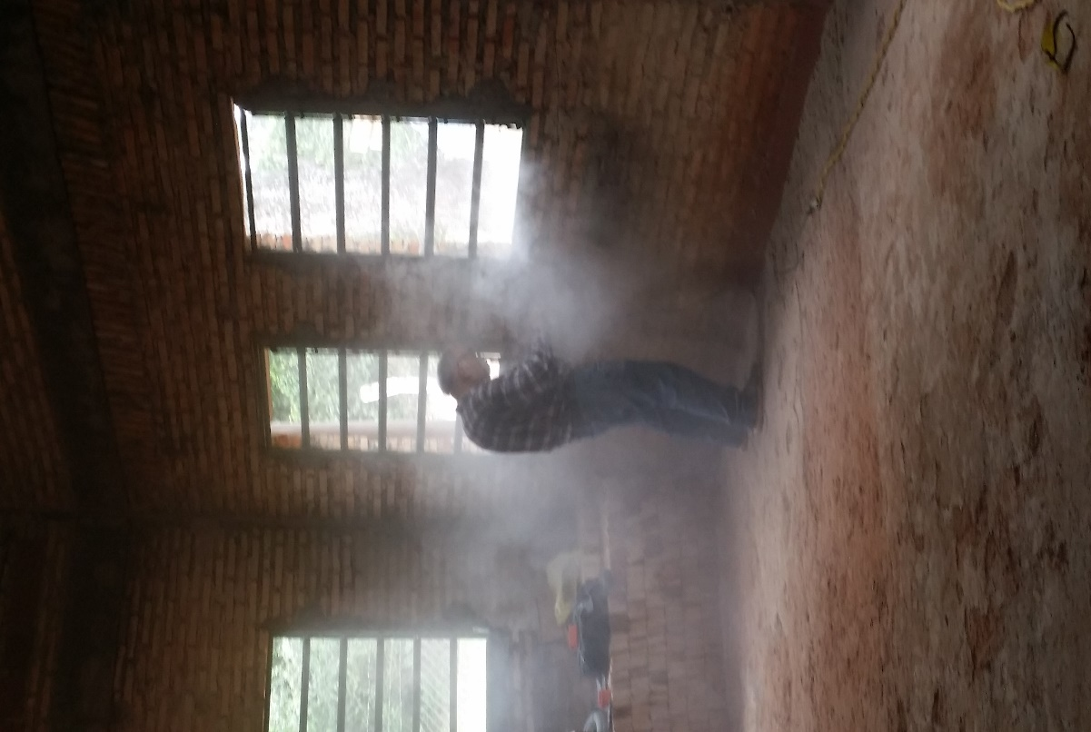
Inside Electrical Construction
Jonathan channels the walls with hammer and chisel
Bob laid out the walls to be channeled
Dave channels the walls with a power cutter!

Slide 12
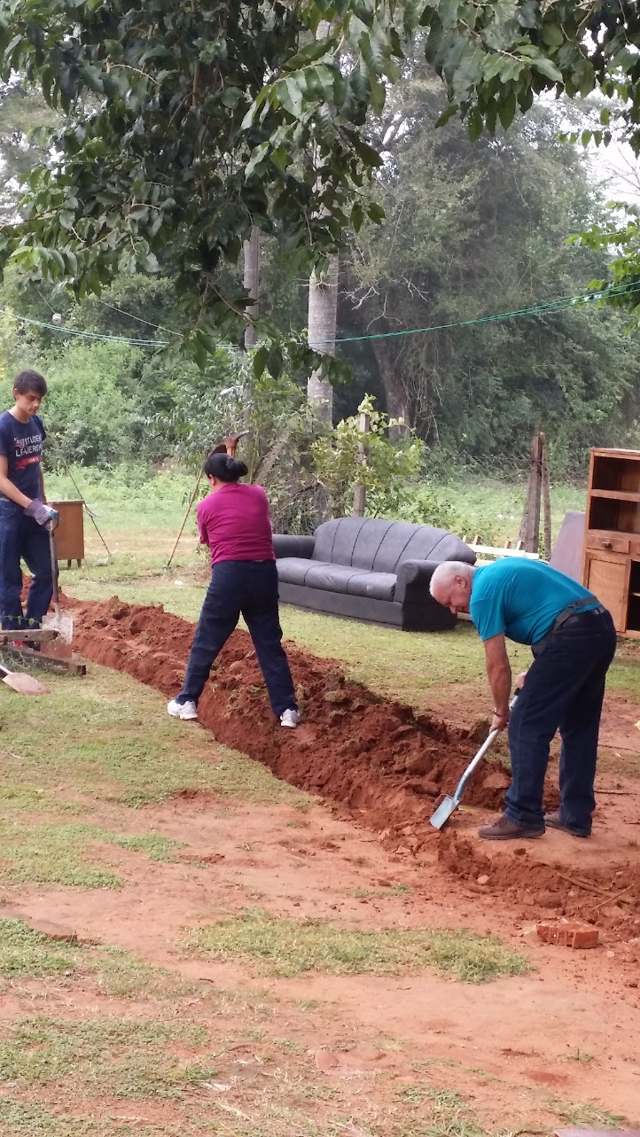
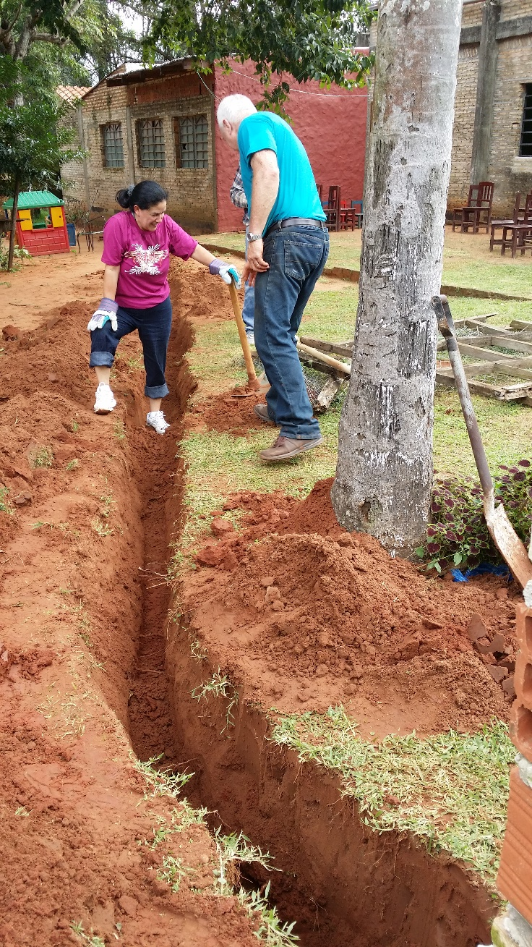
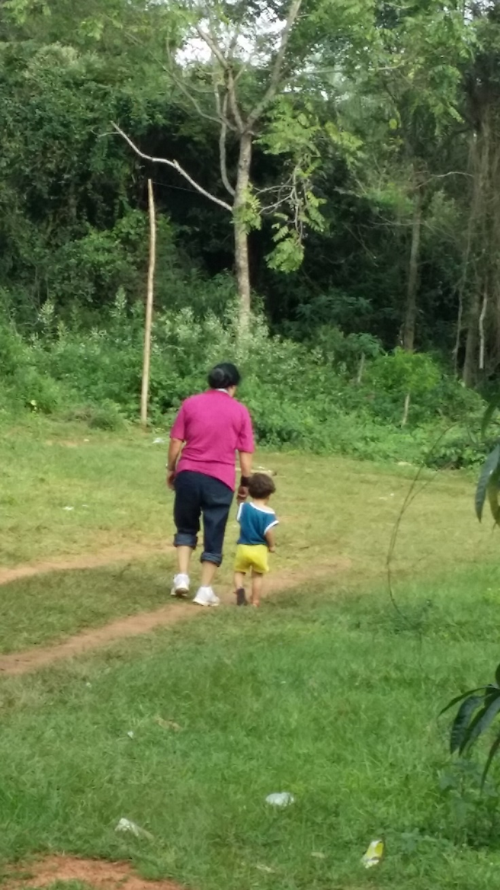
Outside Electrical Construction
Trenching by shovel and pick axe!
…and building relationships
Observing their handy work!

Slide 13
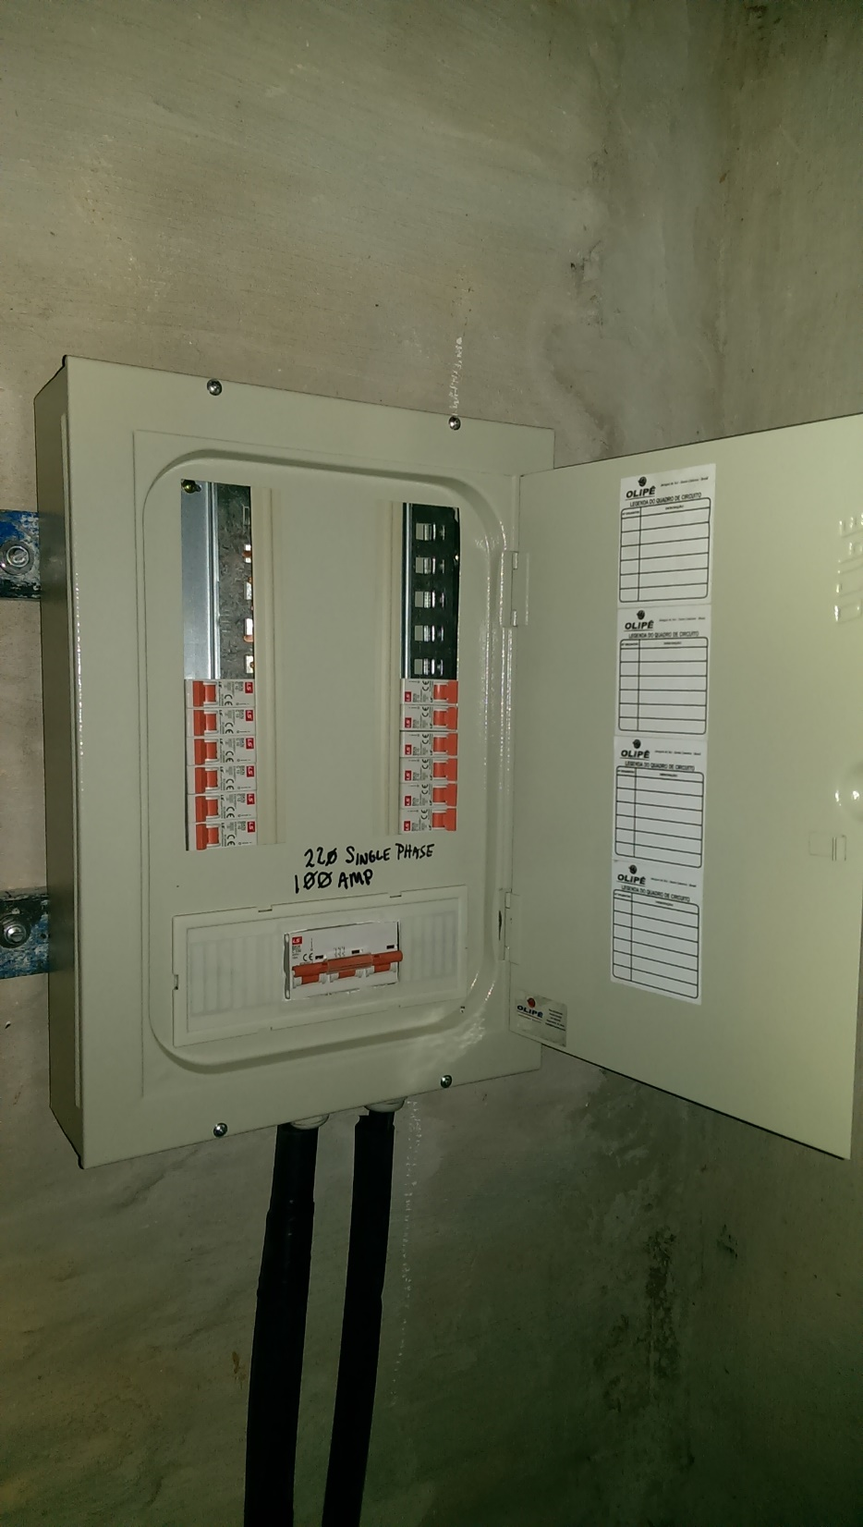
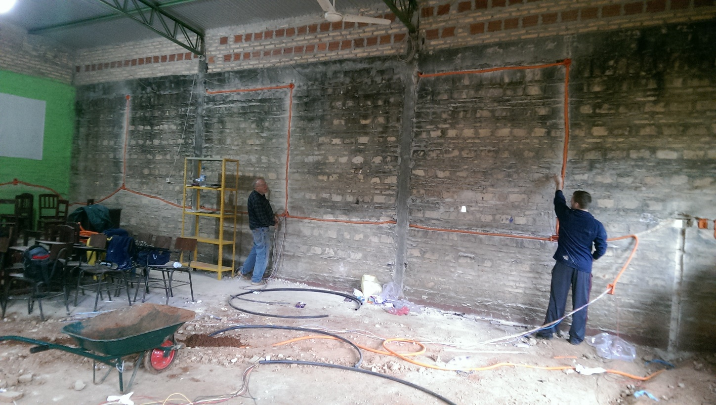
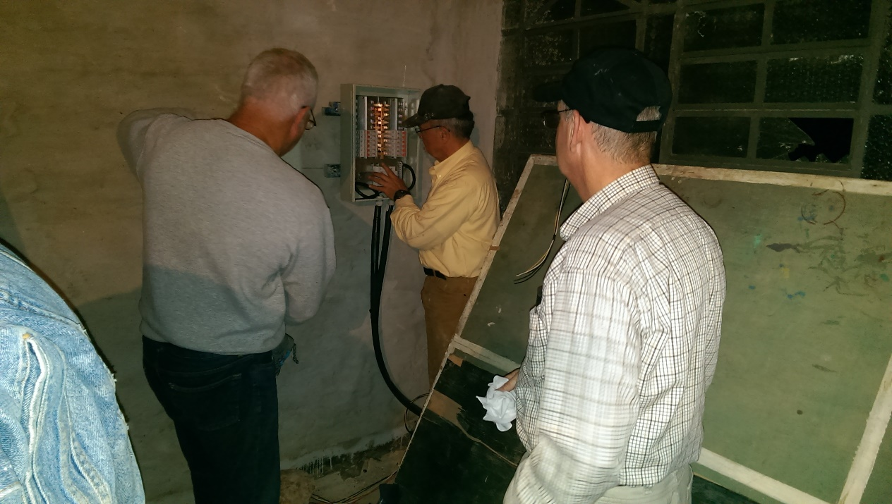
Finishing Touches
Finished work….
Putting Conduit… “tubos” in the walls….
Making up the panel….

Slide 14
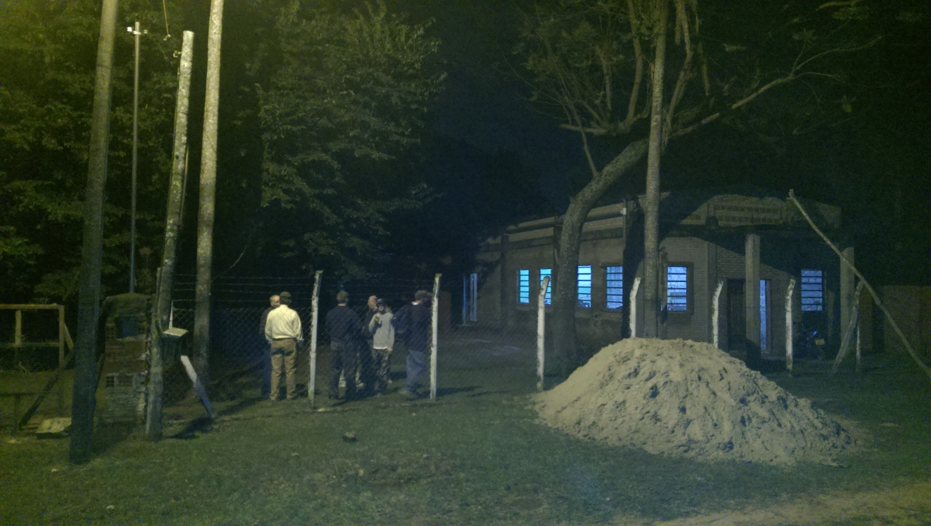
After a Full Day’s Work It’s Quitting Time

Slide 15
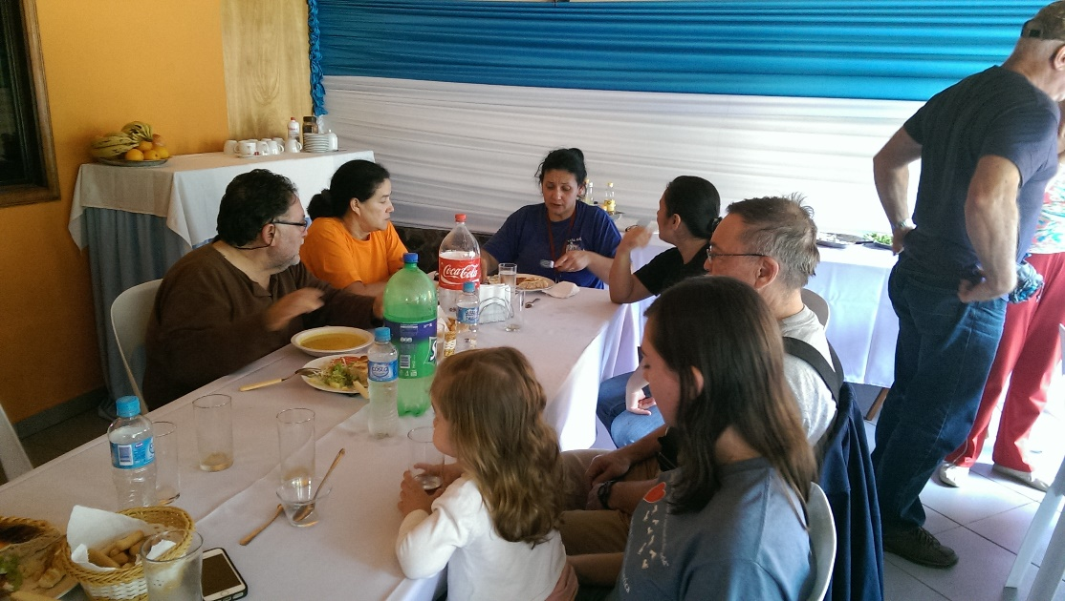
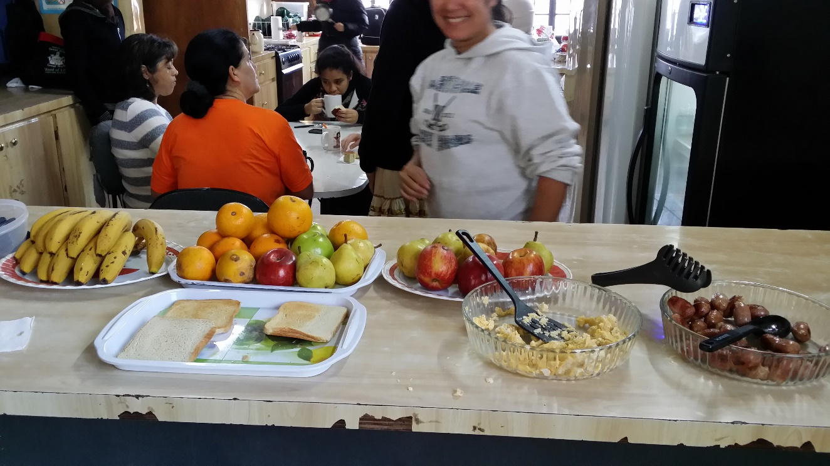
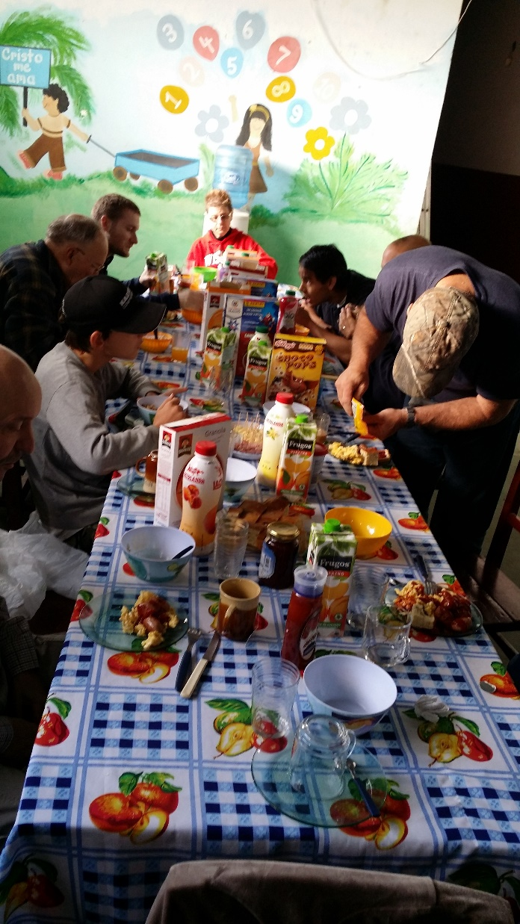
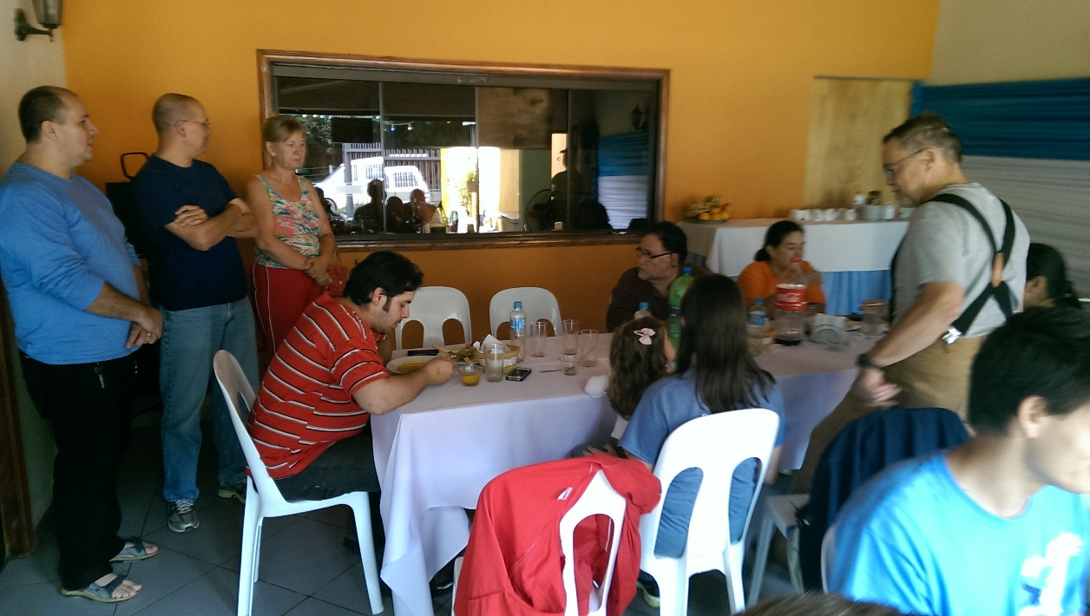
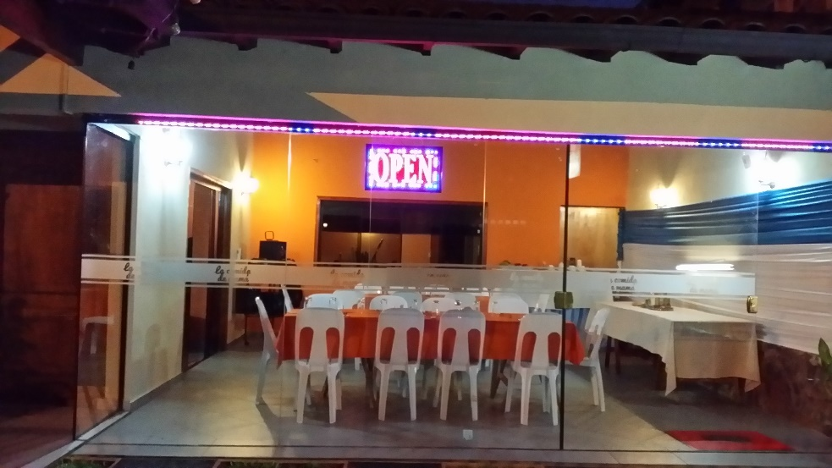
Food, Fellowship and Libation
Breakfast
Cocina de Mama

Slide 16
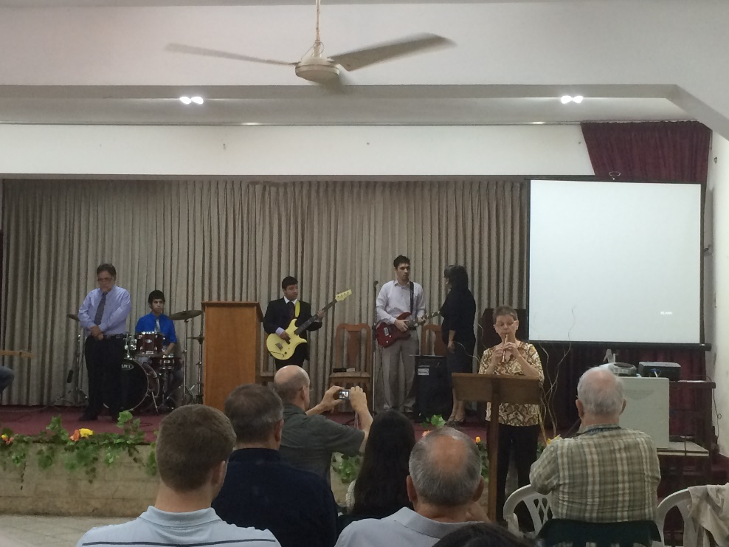
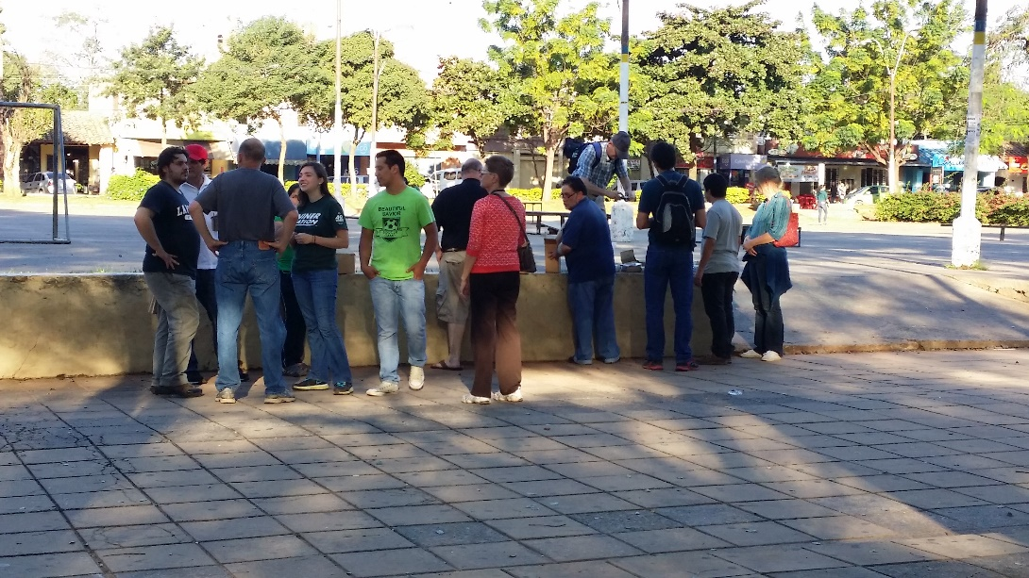
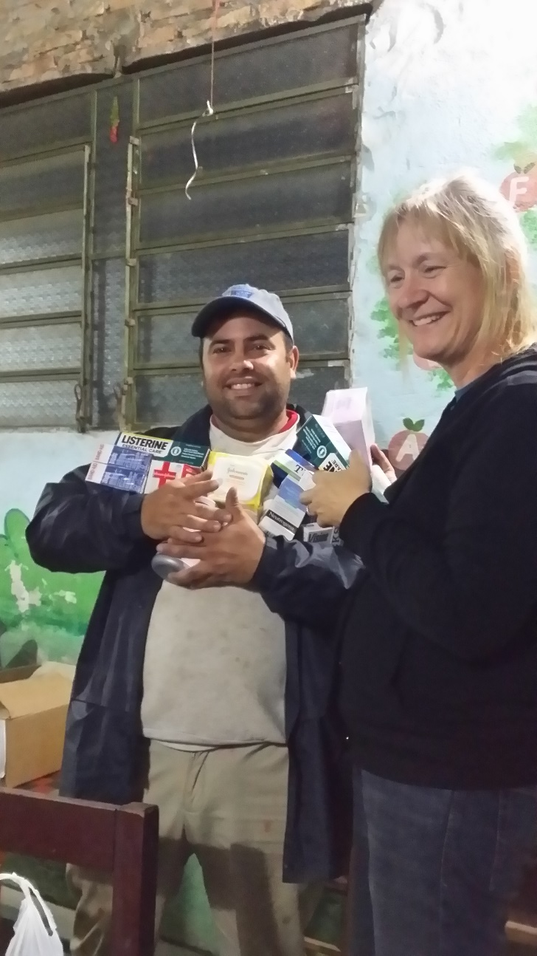
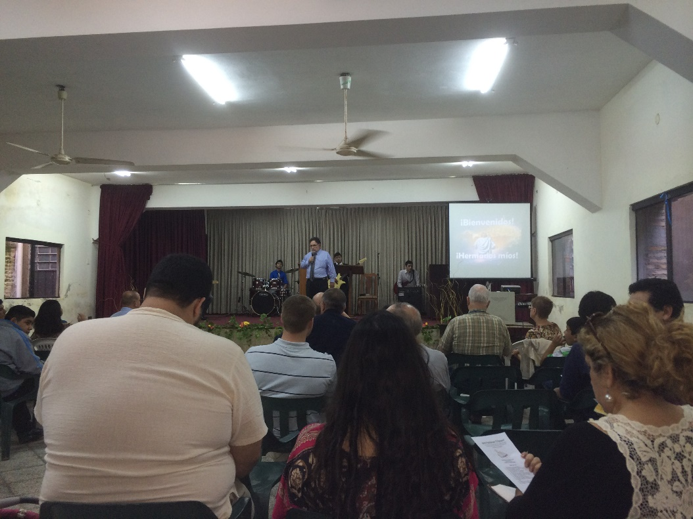
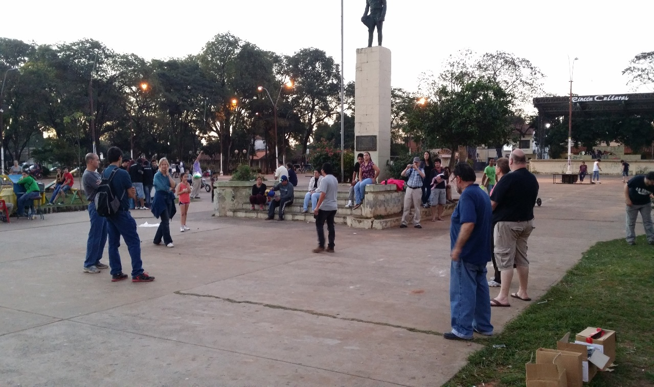
Praise, Worship and Sharing the Word
Donated Medicine
Passing out Spiritual Tracks
Street Preaching
Worshiping Together

Slide 17
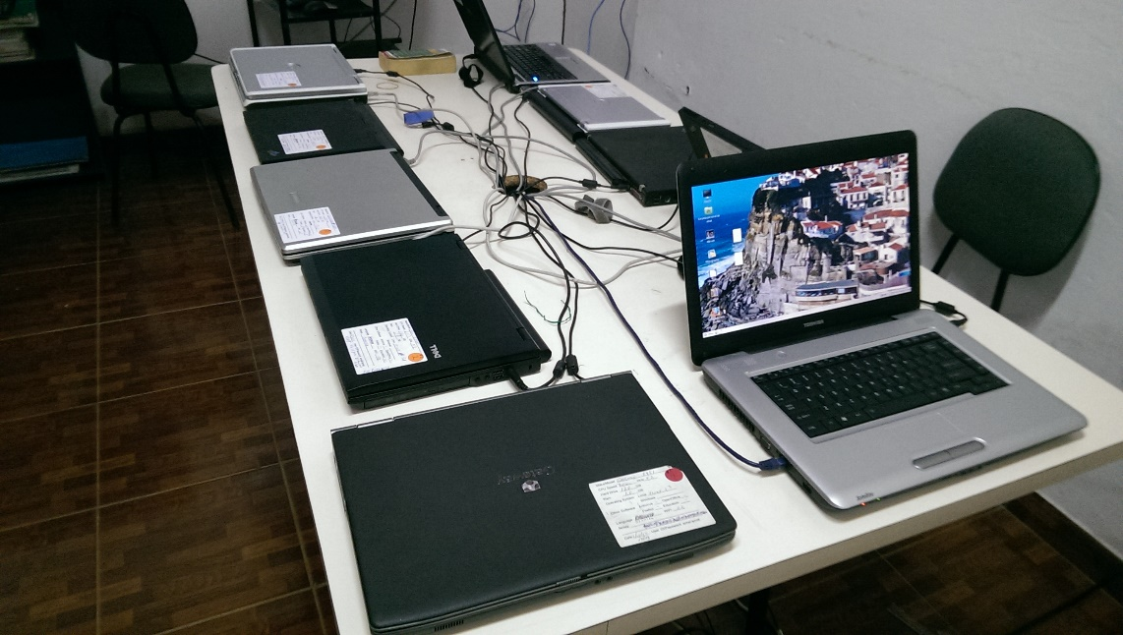
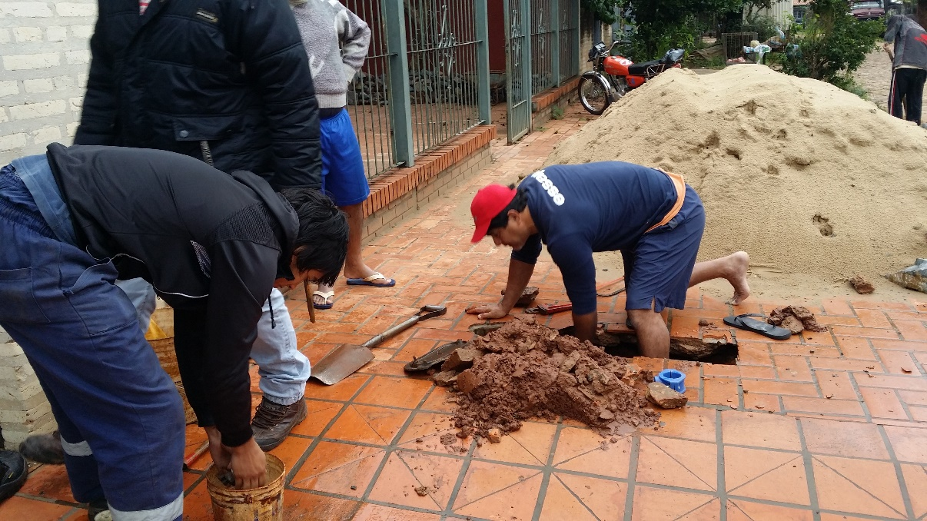
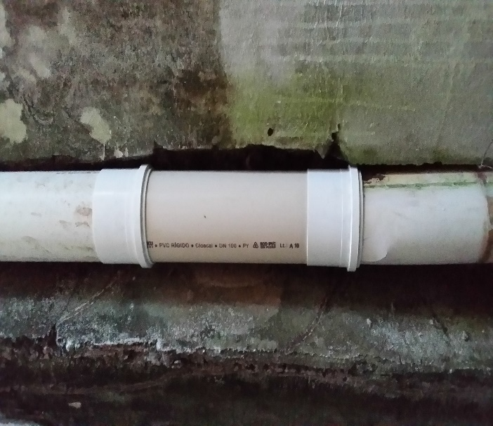



Lots More Too…
Plumbing in Paraguay
Repair of Downspout
Computers for School
Taking care of the books
Music Instruction
Stucco in the Stairwell

Slide 18





Lots of New Friends…family we’ve just met!
Anette
Mrs. Maureira
Tana
Lillanna
Watching Volleyball
Playing Volleyball
Pastor and Wife

Slide 19





Around Barrio Parque

Slide 20




Fun and Recreation

Slide 21





Women’s Conference

Slide 22


Final Goodbyes….until Next Year
There is so….much more that could be shared

Slide 23
What is planned for next year?
Dates are being discussed now for mid/latter July 2016
The electrical must be finished: installing the receptacles, buying and installing the electrical fixtures – interior and exterior
We need workers to commit…all skills, no skills but willing and open hearts filled with the Spirit and ready to share it
What can you do?
Join in the fund raising and give.
Plan to make the trip! (Practice your Spanish…you’ll be glad you did!)
Pray for God’s provision and blessing: wisdom for the leadership, resources and safety

